Slide 1
Socially Responsible Investing (SRI)
Instructor: Professor Henry Wong
Members Presenting:
Naga Nimmakayala -U01823114
Farhan Mohammed - U01819625
Samarth Yadav - U01815170
Harshal Patil - U01825722
Kush Shah - U01788010
Jephthe Louis-Jacques - U00563103
Notes:
Louis-Jacques

Slide 2

Project Description
We are providing millennial and Gen Z ‘Socially Responsible Investors’ (SRI) a free tool to review current companies stock price in comparison to the respective company's overall Socially Responsible' ratings.
This free tool will provide the social responsibility rating of the company along with most recent available articles written about the company as part of diligence when researching.
The site will also partner with third platforms to allow SCIs to create a account and beginning investing in the company of their choice.
Notes:
Louis-Jacques

Slide 3

Persona : End User Persona
Donna, a recent college graduate sees the value of investing her hard earned money but she is new to the space. Donna is very conscious when it comes to investing in companies that are known for conducting unethical practices.
With a low risk tolerance for unethical companies, she is looking for a reliable platform which will give her enough insight to make good investments as a socially conscious investor with no strings attached.
Notes:
Harshal

Slide 4
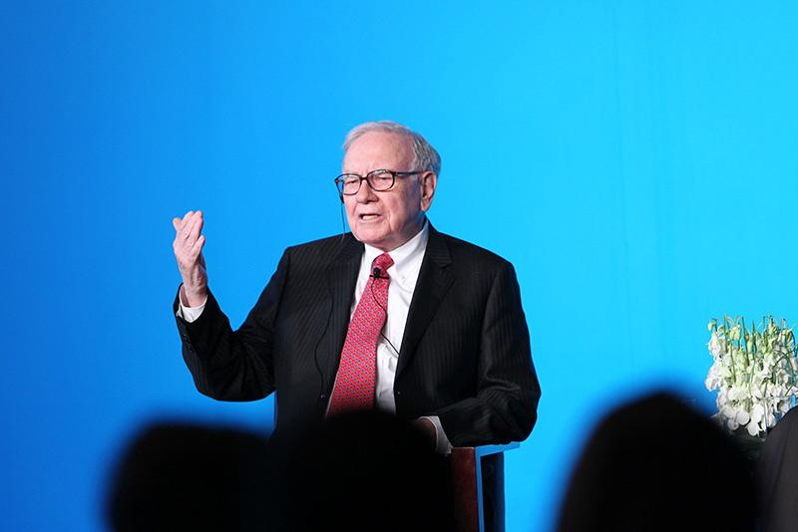
Persona : Influencer Persona
Michael is a famous wealthy long term investors that does public speaking from time to time and encourages his audience to do more diligence about the companies they are investing in.
During speaking engagements, he often suggests easy tools that can help new investors get more insight about conscious investing. Michael often suggests SRI Website to his audience as a great opens source free tool. He also uses SRI for quick research as well.
Notes:
Harshal

Slide 5

Persona : Positioning Persona
Other investor website currently provide paid services like(yahoo finance, fidelity, or IBKR) to obtain market glimpse to align his investments and he is looking for a platform which will provide all the financial and fundamental details about the company for free.
Notes:
Harshal

Slide 6

Persona : Anti-persona
Bob is a hardcore capitalist that doesn't believe companies should be monitored based on ethics.
He believes companies that drive value to the bottom line are the ultimate indicator for investing; regardless if the company doesn't have the best public opinion.
Notes:
Harshal

Slide 7
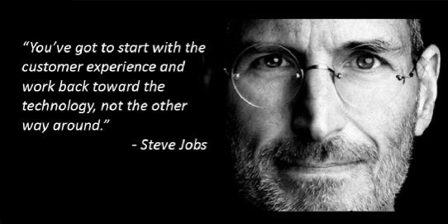
Customer Journey Map
Definition:
A customer journey map is a visual representation of a customer’s experience with your brand. These visuals tell a story about how a customer moves through each phase of interaction and experiences each phase.
Notes:
Farhan

Slide 8
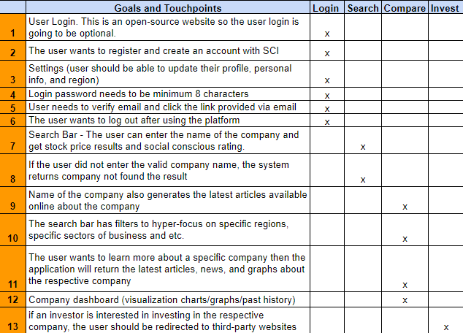
Customer Journey Map
* An investor site is supposed to provide the most accurate data about the company that an investor is looking forward to invest in, how well the company is doing in the current market and provide information on financial performance.
Notes:
Farhan

Slide 9
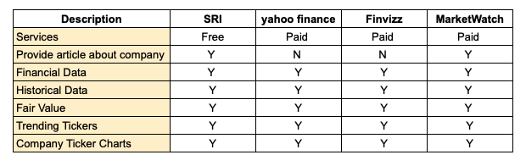
Competition Analysis

Slide 10






Technology Stack
Project Management: JIRA
IDE: Visual Studios (Python)
Backend: GCP (Google Cloud Platform)
Front End: HTML , CSS, Angular/react TBD
APIs: Postman
Visualization Tool: Power BI or Tableau
Notes:
Samarth

Slide 11
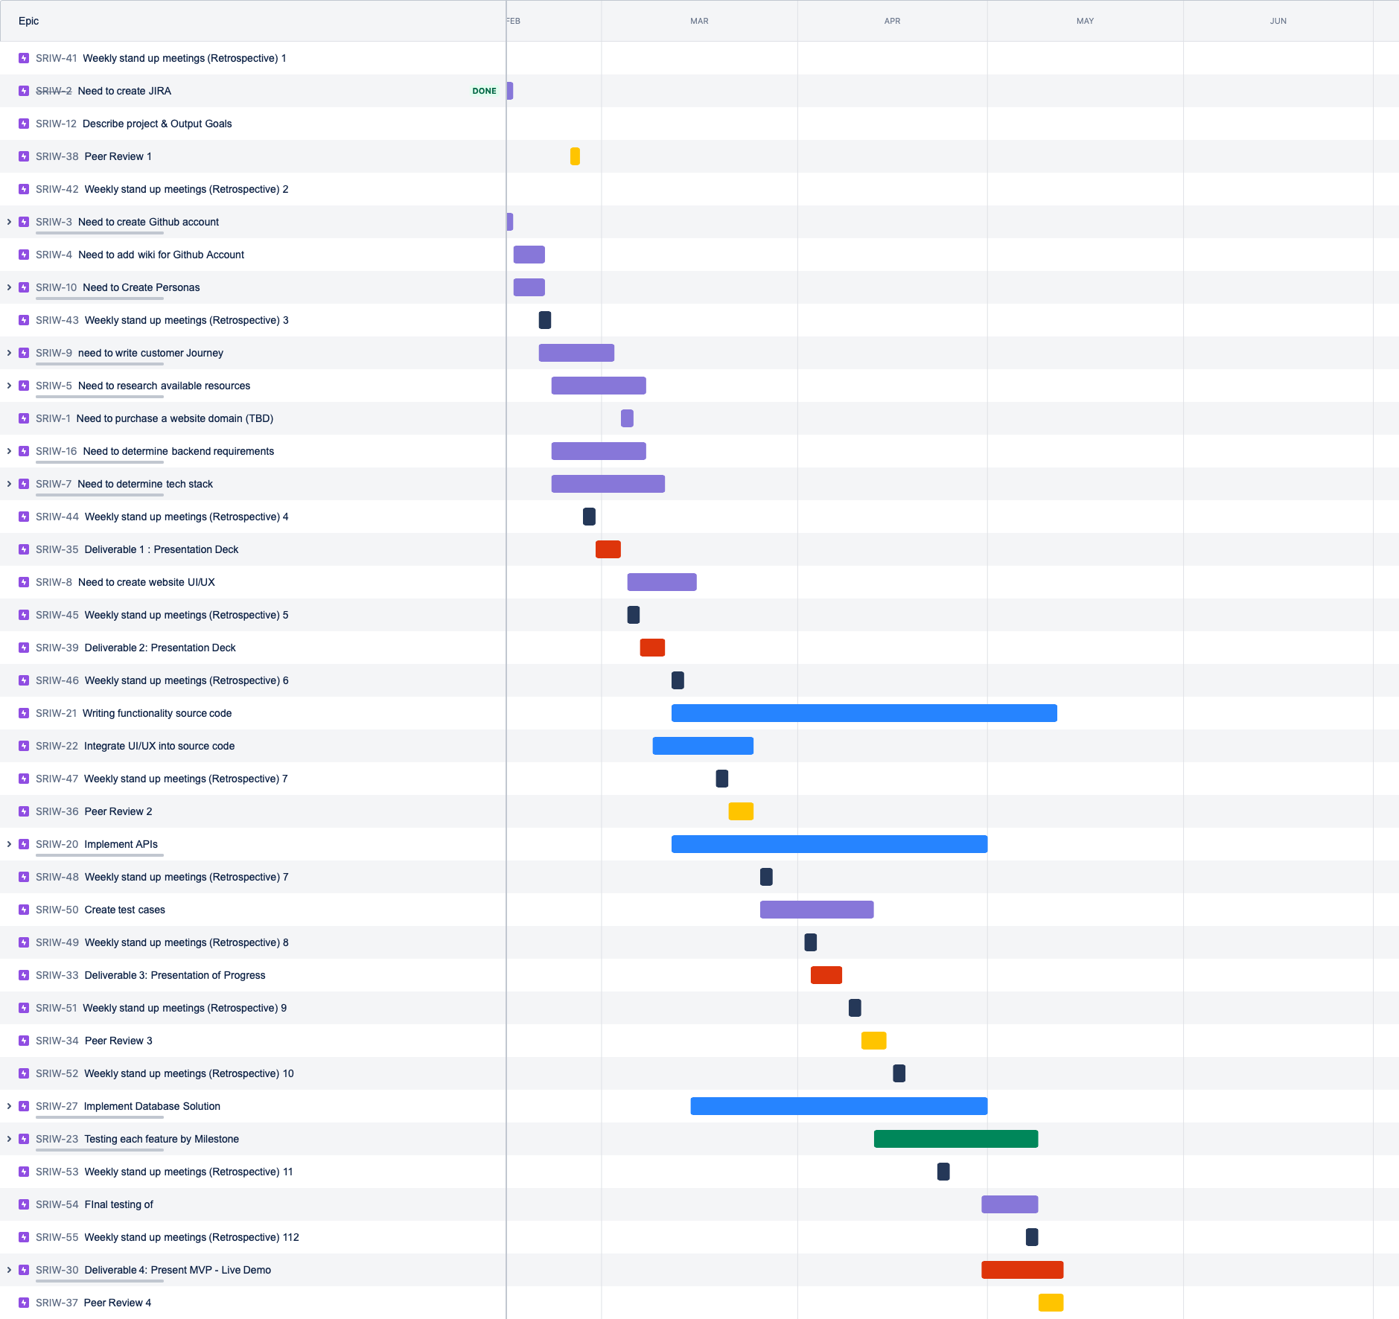
JIRA:
PROJECT MANAGEMENT TOOL
Notes:
Louis-Jacques

Slide 12
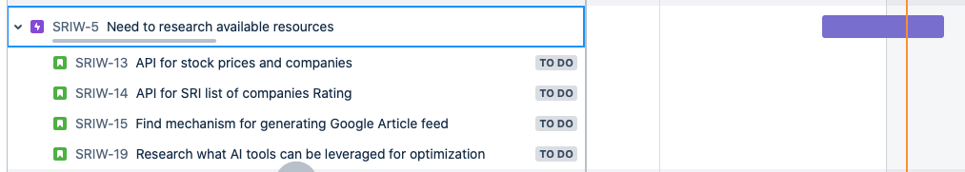
JIRA:
Sprints
Tasks
Notes:
Louis-Jacques

Slide 13

Retrospective
As we planned the project, we realized managing micro-task is important and excel schedules were not good enough so we used JIRA
Working with JIRA made us realize there's a tight timeline to accomplish the project and every week is important
We realize we were limited with the scope of the project since we didn't have experience with various technologies
Initially team members had different ideas to work on, after a weekly standup call we have decided to gather more information and get more insights about our ideas. Discussed/identified roadblocks in our ideas, and finalized project (SRI).
Once the SRI project was finalized by team, we identified highest priority items to work on and put measurable goals on those items so they can be completed on time and it was done using Jira.
Notes:
Kush
We still need to work on how we will manage out meeting so that we can meet up to the deadline
Assign the tasks we need to work on
Start working on the activities assigned

Slide 14
MVP vs Scale App
MVP-Free service with stock price and ranking of SRC
Scale - Free service with login feature, Machine Learning predictive modeling of user profile based on survey of specific sectors they want to invest in
Notes:
Kiran

Slide 15
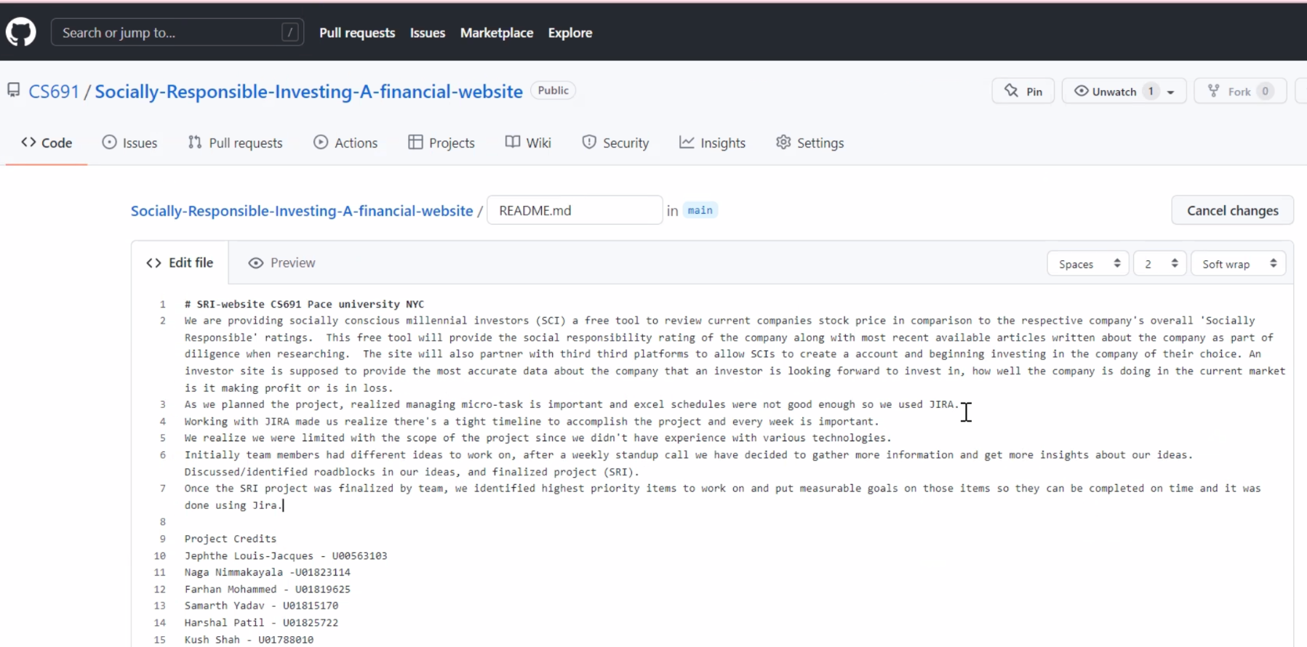
Github Wiki
https://sp22team1.atlassian.net/jira/software/projects/SRIW/boards/1/roadmap?assignee=622045174160640069c6bea6%2Cunassigned&timeline=MONTHS
Notes:
Kiran

Slide 16
THANK YOU!

